Slide 1


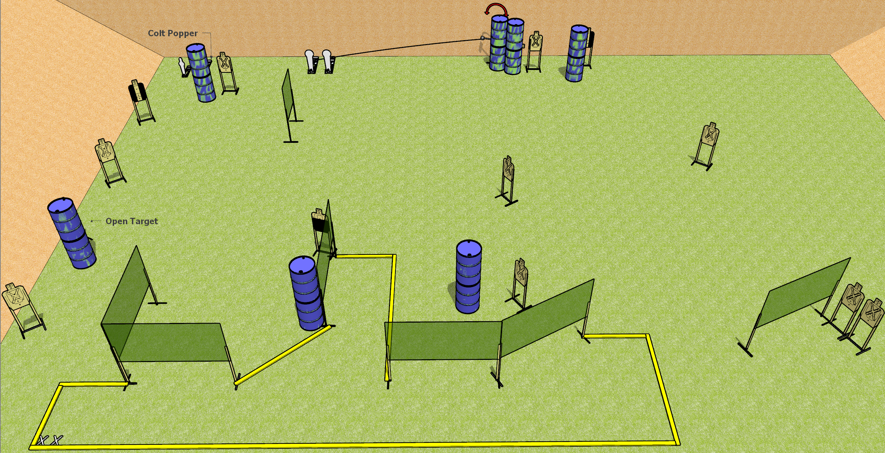
 | Dothan Gun Club – USPSA Match Big Mama’s House Course Designer : Drew Coleman
START POSITION : Standing with feet on X’s, toes touching rear fault line, wrists below belt. PCC feet on X’s, heels touching rear fault line.
GUN READY CONDITION : Pistol loaded and holstered. PCC loaded, held with both hands, stock on belt, safety on. |  | SCORING: Comstock, 32 rounds TARGETS: 14 paper, 4 Steel SCORED HITS: Best 2 on paper, steel until down START-STOP: Audible, last shot RULES:
STAGE PROCEDURE: Engage targets as they become available from within the fault lines.

Slide 2
Big Mama’s House
Written Stage Briefing
Big Mama’s House is a 32 round, 160 point, Comstock field course. There are fourteen USPSA targets, three Colt poppers, and one mini popper. The best two hits on paper will score, and steel must fall to score.
Handgun start position is standing with both feet on X’s, toes touching rear fault line, facing uprange, wrists below belt. Handgun is loaded and holstered.
PCC start position is standing with both feet on X’s, heels touching rear fault line. Loaded carbine is held with both hands, safety on, buttstock on belt.
On start signal, engage targets as they become available from within the shooting area.

